Slide 1
Module 2: Soils and Growing Materials

Slide 2
Learn the Basics of Fertilizer

Slide 3
Learn the Basics of Fertilizer Key Points
Fertilizers provide nutrients that are key for optimal plant health
Primary nutrients are nitrogen (N), phosphorus (P) and potassium (K) and are represents by the 3 numbers display on the package in order of N-P-K
Nitrogen
Help with plant growth above ground
Promoting green leafy growth of foliage
Phosphorus
Effective in establishing growth below ground in the form of healthy root system
Responsible for flower bloom and fruit production
Potassium
Help build strong cells within plant tissues
Help plant withstand heat, cold, pests and diseases

Slide 4
Learn the Basics of Fertilizer Key Points
The NPK number represents the percentage of the primary nutrient relative to the total weight of the package
The rest is considered filler or inert material which help in bulk out the package and make distributing nutrients
Plants can NOT distinguish between organic and man-made fertilizers
Man-made fertilizers distribute nutrients to plant quicker due to it being more water soluble
Excessive fertilizer to plant too quickly can either burn, harm, or kill the plant
Organic nutrients are never in a concentration that is high enough to kill the plant
However, it takes awhile for the nutrient to break down and absorb by the plant

Slide 5
Learn the Basics of Fertilizer Notes (Word Doc)
_________ provide nutrients that are key for optimal plant health
Primary nutrients are _________ (N), _________ (P) and _________ (K) and are represents by the 3 numbers display on the package in order of N-P-K
_________
Help with plant growth above ground
Promoting green leafy growth of foliage
_________
Effective in establishing growth below ground in the form of healthy root system
Responsible for flower bloom and fruit production
_________
Help build strong cells within plant tissues
Help plant withstand heat, cold, pests and diseases

Slide 6
Learn the Basics of Fertilizer Notes (Word Doc)
The NPK number represents the _________ of the primary nutrient relative to the total weight of the package
The rest is considered _________ or _________ which help in bulk out the package and make distributing nutrients
Plants _________ distinguish between organic and man-made fertilizers
_________ fertilizers distribute nutrients to plant quicker due to it being more water soluble
Excessive fertilizer to plant too quickly can either burn, harm, or kill the plant
_________ nutrients are never in a concentration that is high enough to kill the plant
However, it takes awhile for the nutrient to break down and absorb by the plant

Slide 7
Learn the Basics of Fertilizer Quiz
What is the role of fertilizers
Plants can distinguish between man-made fertilizer and organic fertilizer (True/False)
What can happen if we use too much man-made fertilizer?
What is the downside of organic fertilizer?

Slide 8
How Does Fertilizer Work?

Slide 9
How Does Fertilizer Work Key Points
Plants requires higher quantity of macronutrients and lower quantity of micronutrients
Nitrogen is important for Amino Acid and photosynthesis
Phosphorus helps form cell membranes
Potassium is important for carbohydrate synthesis and helps plants fight infections
Fertilizers can be straight or mixed
Straight fertilizers contain only 1 nutrient
Mixed or complete fertilizers contain all 3 major nutrients
The first number refers to Nitrogen
The second to Phosphorus
The third to Potassium
The number in bracket is the total amount of nutrient in percentage

Slide 10
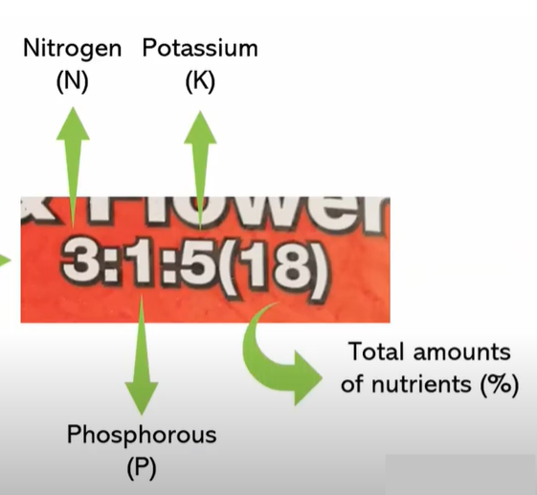
How Does Fertilizer Work Notes
Plants requires higher quantity of __________ and lower quantity of ____________
__________ is important for Amino Acid and photosynthesis
__________ helps form cell membranes
__________ is important for carbohydrate synthesis and helps plants fight infections
Fertilizers can be __________ or __________
__________ fertilizers contain only 1 nutrient
__________ or complete fertilizers contain all 3 major nutrients
The first number refers to __________
The second to __________
The third to __________
The number in bracket is the total amount of nutrient in percentage

Slide 11
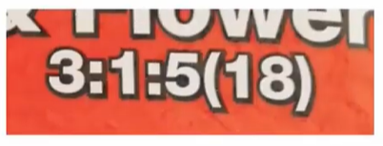
How Does Fertilizer Work Quiz
Label The Following

Slide 12
How to use crop rotation?

Slide 13
How To Use Crop Rotation: Key Notes
Avoid putting the same type of plant in the same soil, season after season
Crop rotation is most efficient when the crops are split by nutrient needs and vulnerability to pests and diseases
Crop rotation is only useful when growing in soil, you do not need to rotate crops in a hydroponic system

Slide 14
How To Use Crop Rotation Notes
_______ putting the same type of plant in the same soil, season after season
Crop rotation is most efficient when the crops are split by ___________and ___________ to pests and diseases
Crop rotation is only useful when growing in soil, you do not need to rotate crops in a hydroponic system

Slide 15
How To Use Crop Rotation Quiz
We must rotate crops in a hydroponic system (T/F)

Slide 16
How To Make Compost At Home

Slide 17
How To Make Compost At Home: Key Notes
Container for composting must have holes to allow air in
Egg shells provides calcium carbonate
Banana peel adds potassium and small amounts of nitrogen, phosphorus and magnesium
Kitchen waste adds nitrogen
To help the compost break down faster, cut compost items to smaller pieces
Can also add:
Wood chips
Paper
Coffee grounds
Green materials are high in nitrogen
Runoff water is optionally reusable
Mix compost regularly to decompose faster
Compost can be stored in a plastic bag

Slide 18
How To Make Compost At Home: Key Notes
Container for composting must have holes to ______
Egg shells provides ______
Banana peel adds ______ and small amounts of ______, ______ and ______
Kitchen waste adds ______
To help the compost break down ______, cut compost items to smaller pieces
Can also add:
Wood chips
Paper
Coffee grounds
Runoff water is optionally reusable
______ _______ regularly to decompose faster
Compost can be stored in a plastic bag

Slide 19
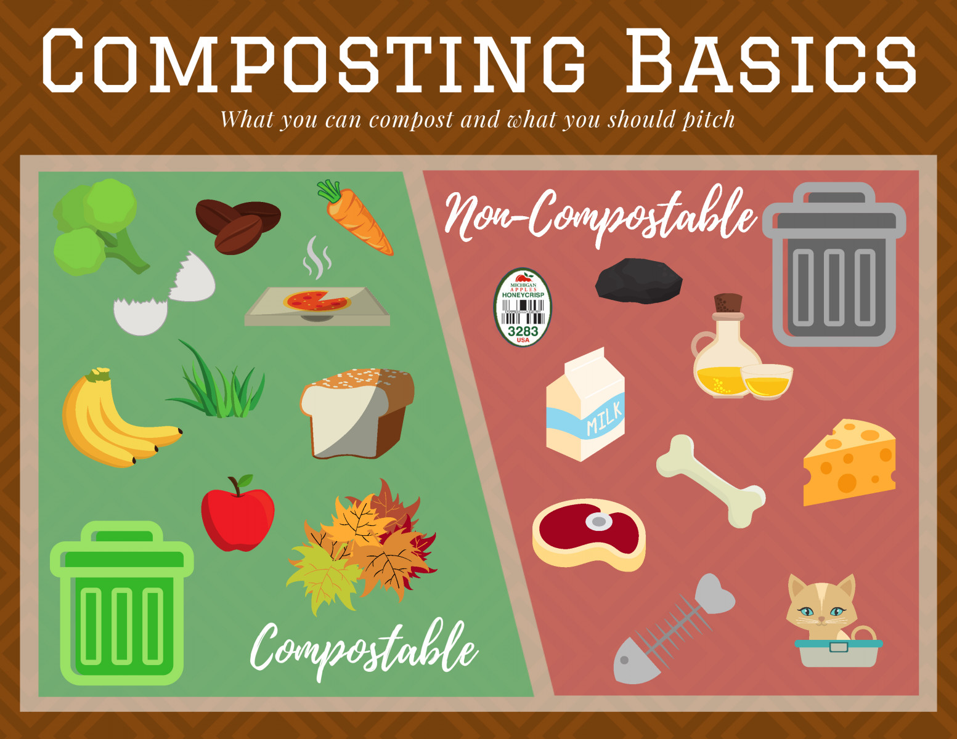
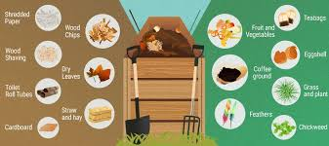
How To Make Compost At Home: Quiz
What items below can be use for compost (Matching with pictures)

Slide 20
Composting - Garden Organic's Video Guide: How To Make Compost

Slide 21
Compost Part 2 of 2 (Combine these 2 videos)

Slide 22
Composting - Garden Organic's Video Guide: How To Make Compost: Key Notes
Place the compost bin on open soil
Place bin on level ground
Plastic can not be composted
Do not put any meat scraps and cooked food in the compost bin
Cardboard and newspaper can be used
Mix greens and browns
Vegetable scraps mix well with paper and cardboard
Add water if dry

Slide 23
Composting - Garden Organic's Video Guide: How To Make Compost: Notes
Place the compost bin on open soil
Place bin on _____ ground
Plastic ________ be composted
________ put any meat scraps and cooked food in the compost bin
Cardboard and newspaper _____ be used
Mix greens and browns
Vegetable scraps mix well with paper and cardboard
Add water if dry

Slide 24
Composting - Garden Organic's Video Guide: How To Make Compost: Quiz
Circle the correct respond
Plastic can / cannot be composted
Do/ Do not put any meat scraps and cooked food in the compost bin
Cardboard and newspaper can / cannot be used

Slide 25
Why Compost?

Slide 26
Why Compost Key Notes
Allows food waste to degrade in presence of oxygen
No methane is produced
Produce organic fertilizer
Divert food waste from landfill

Slide 27
What Is Soil?

Slide 28
What Is Soil? Key Notes
Salinization blocks plants from being able to absorb water and nutrients
Soil is a complex collection of minerals, organic mater, air, and water.
Humus is made of organic material like leaves and partly decomposed plants and animals.
Humus supplies energy and nutrients and influences the color, texture, structure, and chemical properties of a soil and how much water and air it can hold.
Podzolization - As pine needles decompose, they make the soil more acidic, which leaches out aluminum and iron compounds from the A horizon. The remaining silica gives the E horizon a distinctive ash-gray color.

Slide 29
What Is Soil? Notes
_________ blocks plants from being able to absorb water and nutrients
Soil is a complex collection of ________, ____________, ____, and _______.
______ is made of organic material like leaves and partly decomposed plants and animals.
Humus supplies energy and nutrients and influences the color, texture, structure, and chemical properties of a soil and how much water and air it can hold.
___________ - As pine needles decompose, they make the soil more acidic, which leaches out aluminum and iron compounds from the A horizon. The remaining silica gives the E horizon a distinctive ash-gray color.

Slide 30
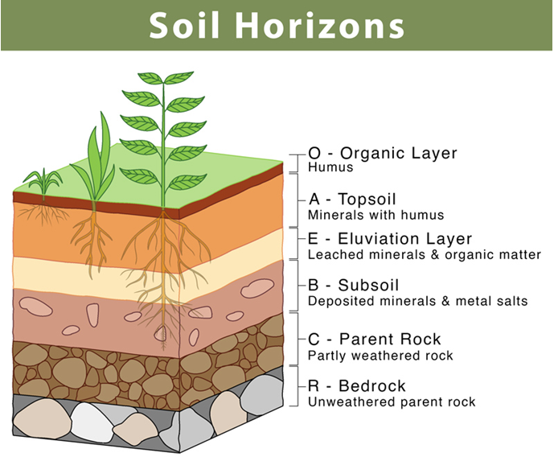

Slide 31
Soil Horizons: Fill in the blank
1. Label The Following

Slide 32
Soil and Soil Dynamics

Slide 33
Soil and Soil Dynamics Key Notes
Soils start with rock that weathers over time, both chemically and mechanically
Physical is any breaking down of a rock that increases the surface area
Chemical is any oxidation or other reactions that contribute to the breakdown of a rock
Soil is the interface between the biosphere (living things), the hydrosphere (water), atmosphere (air), and the lithosphere (earth).
A good deal of time goes into soil
Soil is 45% mineral, 5% organic, 25% water, and 25% air (differs by the soil but vague breakdown)

Slide 34
Soil and Soil Dynamics Key Notes
- Horizons:
O - organic (dead material)
A - topsoil (mix of organics and minerals
E - (alleviation water moves down and a dry mineral layer exists between top and subsoil)
B - subsoil (few organics more minerals)
C - parent rock
Particle sizes
Sand: 0.05-2mm
Silt: 0.002-0.05mm
Clay: <0.002mm
Porosity: How well can the soil drain itself?
Sand drains the fastest, clay drains by far the slowest

Slide 35
Soil and Soil Dynamics Key Notes
Hundreds of years go into the weathering of rock into soil, meaning that it is not a particularly renewable resource
Rock Cycle: rocks start igneous (from fire) and can break down and become sedimentary, or change around and become metamorphic
These rocks at some point whether into soil when on the surface
Soil triangle is a breakdown of sand, silt, and clay
Anything over 50% clay will behave like clay and will not be useful
20% clay, 40% sand and silt will be a loam or an ideal breakdown

Slide 36
Soil and Soil Dynamics Key Notes
Cation exchange capacity is an important concept positively charged nutrient cations are attracted to negatively charged organic molecules and clay
Soil compaction can erode soil (heavy machinery on wet soil) leads to little to no air in the soil
Salinization happens through flood irrigation
When plants take in water, they leave salts behind
These are normally washed away by rain
When the water is drawn from the ground then it depletes the soil of water leaving only salt
Salt resistant crops, wash with fresh water or crops with bigger roots are potential solutions
The idea is that soil is by no means renewable at the rate we are consuming/damaging it

Slide 37
Soil and Soil Dynamics Notes
Soils start with rock that weathers over time, both chemically and mechanically
________ is any breaking down of a rock that increases the surface area
________ is any oxidation or other reactions that contribute to the breakdown of a rock
Soil is the interface between the ________ (living things), the ________ (water), ________ (air), and the ________ (earth).
A good deal of time goes into soil
Soil is 45% mineral, 5% organic, 25% water, and 25% air (differs by the soil but vague breakdown)

Slide 38
Soil and Soil Dynamics Notes
Hundreds of years go into the weathering of rock into soil, meaning that it is not a particularly renewable resource
Rock Cycle: rocks start igneous (from fire) and can break down and become sedimentary, or change around and become metamorphic
These rocks at some point whether into soil when on the surface
Soil triangle is a breakdown of ________, ________, and clay
Anything over 50% clay will behave like clay and will not be useful
20% clay, 40% sand and silt will be a loam or an ideal breakdown

Slide 39
Soil and Soil Dynamics Notes
Cation exchange capacity is an important concept positively charged nutrient cations are attracted to negatively charged organic molecules and clay
Soil compaction can erode soil (heavy machinery on wet soil) leads to little to no air in the soil
________ happens through flood irrigation
When plants take in water, they leave salts behind
These are normally washed away by rain
When the water is drawn from the ground then it depletes the soil of water leaving only salt
Salt resistant crops, wash with fresh water or crops with bigger roots are potential solutions
The idea is that soil is by no means renewable at the rate we are consuming/damaging it

Slide 40
Guide Sheets

Slide 41
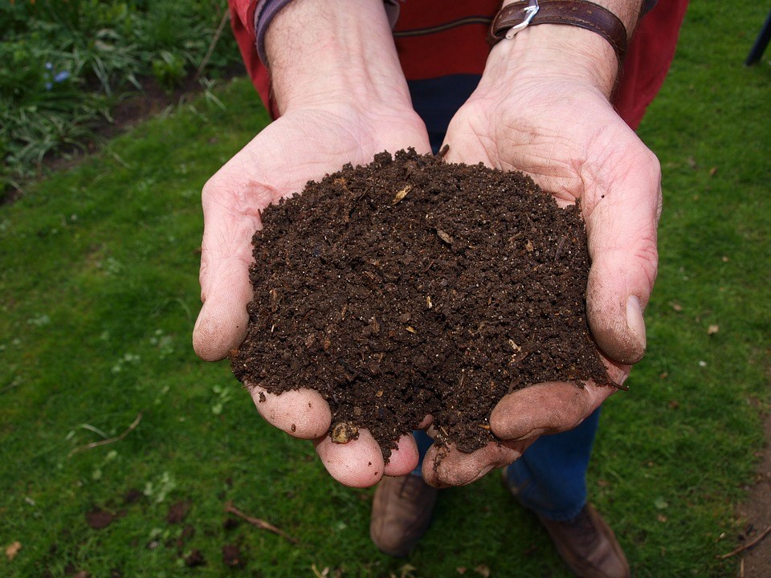
Composting Guide Sheet
Benefits
Decreases municipal collection and disposal cost
Decreases the amount of garbage → Decrease curb side garbage collection → Less collection required → Decreases cost
Prolong the life of landfill
Landfills are designed to keep air and moisture out, which are necessary for decomposition. Methane gas and leachate are produced when organics break down under these conditions, so putting less organic waste into the household trash
Improves soil quality and plant health by:
Retains moisture
Prevents erosion
Replenish nutrients in soil
Reduces the need to water gardens
Eliminates the need to purchase other fertilizers
It is FREE
What is composting?
Natural process of decomposition and recycling of organic material into humus (a rich soil additive)

Slide 42
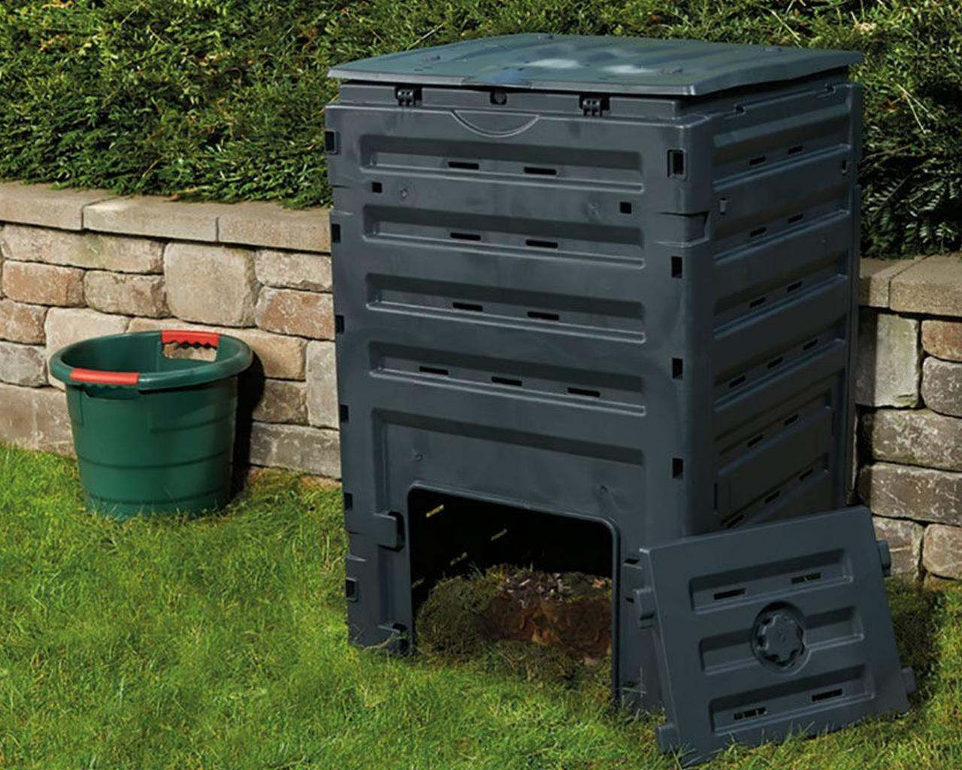
Compost bins
Compost bins are usually large black boxes made from plastic with a lid at the top to put in plant material and a small door at the bottom where the compost comes out.
Pros:
Large Capacity
Easy To Use
Premade
Cons:
Manual Mixing

Slide 43
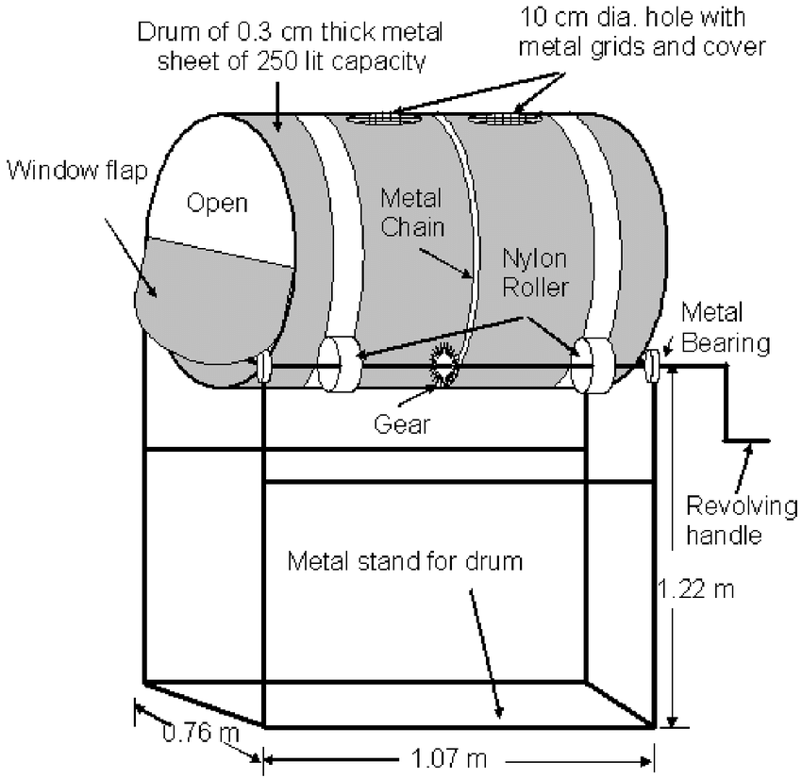
Rotating Composter
Rotating composters are made of black plastic and are similar to compost bins, but they spin to turn the compost over.
Turning over compost is important to keep air in it and to make sure it is mixed well.
Pros:
Easy to use
Easy to mix compost
Cons:
Need to introduce worms and bugs
Smaller capacity

Slide 44
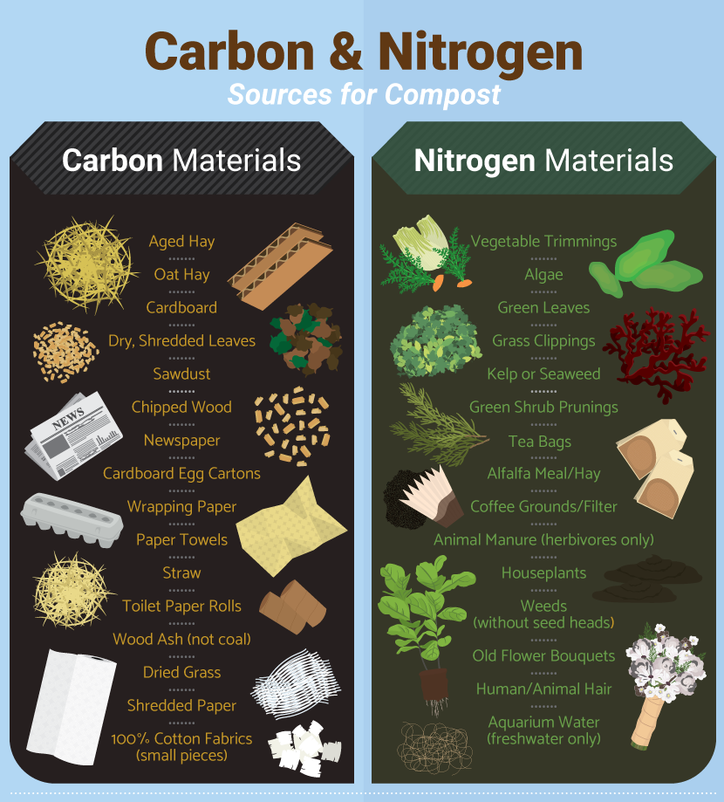
What Can Be Composted?
DO NOT COMPOST
Meat
Bones
Dairy products
Cooking oil
Invasive plants (e.g. Himalayan balsam, Japanese knotweed)
Human or pet wastes
Charcoal or coal ashes

Slide 45
How To Compost?
Setup
Composting can take place in a bin or a pile. Bins help keep the compost neatly contained and can keep animals and pests out.
Can purchase a composting bin or build one from wood or wire mesh.
The best place for the composter is in a convenient, sunny location on level ground with adequate drainage
.
Place a layer of sticks at the bottom of the composter to keep the pile aerated. Place 5 or 6 centimeters of small branches or twigs at the bottom of the composter and make a hole in the center (like a nest)
Put a layer of dead leaves, compost or earth. Preparing the bottom of the composter will allow for better aeration, stabilize humidity and prevent decomposing matter from compacting into the ground. Then alternate layers between browns and greens.
Avoid adding thick layers of any one type of waste
New materials should be placed in the center, which is the most active area of the pile, while partially decomposed materials should go on the outer edges of the pile
The process requires moisture and oxygen, so it is important to keep the pile moist and turn it regularly with a shovel or pitchfork
To finish composting sooner, stir it as often as every 3 to 5 days. Otherwise, turning every couple of weeks in warm weather will be sufficient

Slide 46
How To Maintain?
Compost needs air
Every 2-3 weeks, before adding new material, mix the pile with a compost turner, pitchfork, or other garden tool.
Garden stakes, pipes, or even simple holes poked with a broom handle can also help allow air into the pile.
An unmixed pile will compost very slowly and may create an unpleasant smell.
If aeration is not properly achieved, the materials will rot and start to smell
Compost needs water.
Humidity is key to bacteria development
Keep the pile about as moist as a well-wrung sponge
Do not forget to try to recycle and use harvested rainwater or leftover (non-dairy!) beverages.

Slide 47
Using Finished Compost
Finished compost should feel like a wrung-out sponge. When squeeze a handful of it, no more a couple drops of liquid should come out. It should be a dark brown colour and should have a pleasant earthy smell to it.
Wait until the pile is fully inactive before using the compost. The microbial activity generates heat, so when finished, the centre of the pile should no longer feel hot.
Can also screen out larger items that have not broken down (twigs, etc.), return them to the pile, and spread finished compost onto the lawn as a top dressing, no more than 1cm deep.
Finished compost can be used in many ways:
High in nutrients, it can be applied as desired to gardens, houseplants, hedges, and bushes.
You may wish to screen or sift your compost through wire mesh. Sifted compost can be used as potting mix and for starting seeds and plants. Sifted compost is also an excellent top dressing for lawns.
The woody leftovers or un-composted materials can be used as mulch or composted again.

Slide 48
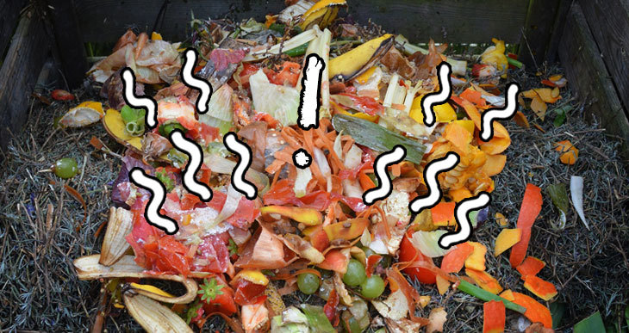
Odour
Possible Solutions
Mix in dry browns.
Turn the compost to add air.
Add some untreated wood ashes, sawdust, or shredded newspaper.
If drainage is a problem, building a plank floor can help.
If it smells like rotten eggs, turn the pile for several consecutive days until the smell is gone, and top the pile with soil or finished compost.
When adding new material, make a hole in the top of the pile, stir in the organics, and cover with dry ingredients such as leaves. Always try to have a layer of browns on top of the pile
Can also add soil at any stage of the layering process. A thin layer of soil added on the top of the pile also helps to discourage pests and prevent odours
Possible Causes
Not enough air
Too wet
Too compacted
Too many “greens”
Too much food waste

Slide 49
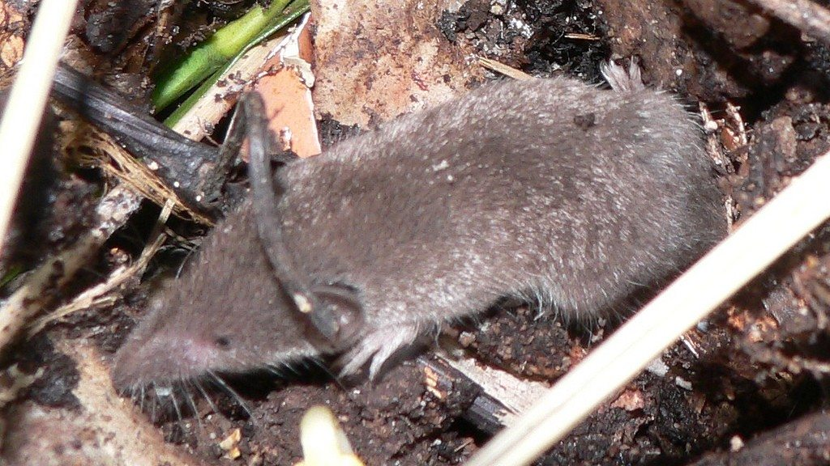
Animals And Pests Issues
Possible Solutions
Ensure the lid is closed and locked after adding and mixing materials
Always completely cover food residuals with a layer of browns, soil, or finished compost
Ensure that fats, oils, meats, seafood and dairy are excluded. Put only vegetable matter in your composter
A fine wire mesh under the compost bin will discourage vermin if necessary. Wrap the bottom of the composter in strong wire mesh (1/4 inch hardware cloth)
Move your composter out in the open, rather than close to a fence or shed. An open area makes rats more vulnerable to predators.
Visit your composter more often!
Possible Causes
Food residuals exposed
Bin unprotected
Notes
Critters like worms, centipedes, and other insects should appear in the composter to help the bacteria break down the material

Slide 50
Slow Composting
Possible Causes
Not enough greens
Not enough air
Not enough moisture
Possible Solutions
Add more greens, mix thoroughly, and ensure the pile is moist
Can also add soil at any stage of the layering process.
A shovel-full of soil will introduce many soil organisms into the pile and act as an accelerator

Slide 51
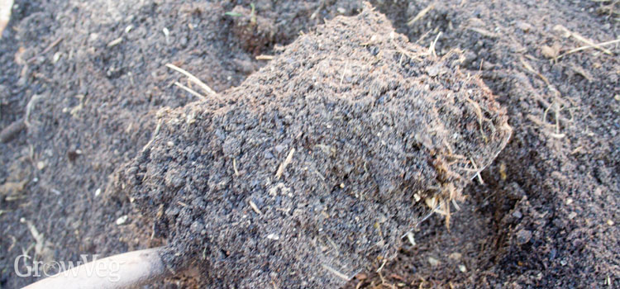
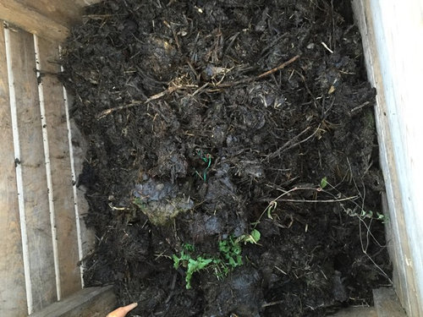
Humidity
If too dry
Dust appears when turned, it does not stick together when squeezed a handful
Add water or leave the lid open when it rains
If too wet
Add carbon-rich (“browns”) to absorb moisture

Slide 52
Why Compost?
Composting naturally supplements the nutrient content of existing soil
It can reduce food and other household wastes
Acts as a natural fertilizer
Improves food yield and quality

Slide 53
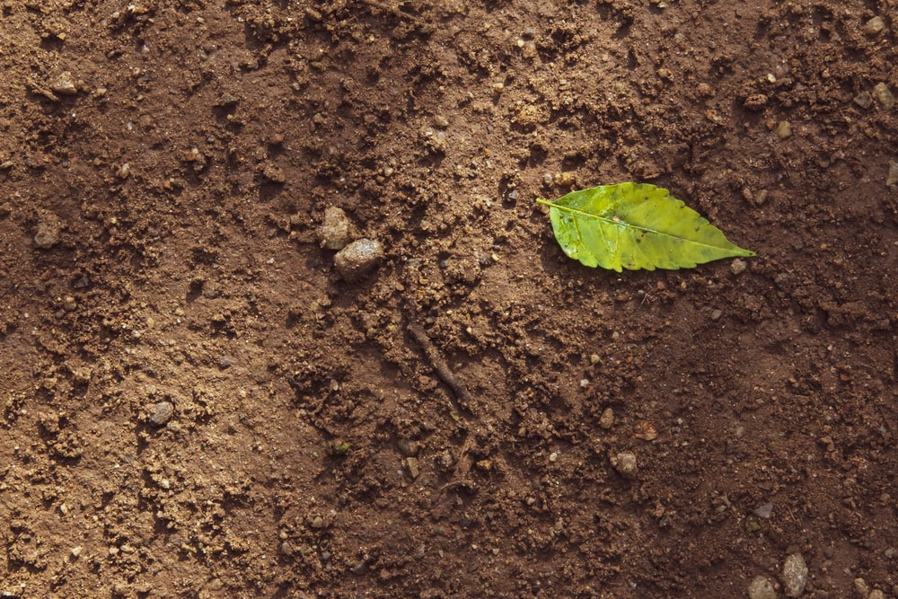
Soil Types Guide Sheet

Slide 54
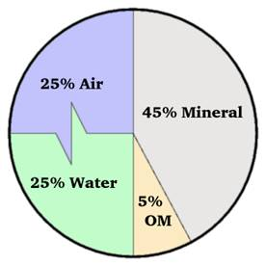
Soil Composition
Soil comprises four main components:
Minerals ~45%
These mainly include sand, silt, and clay
The breakdown of these three items indicates soil type
Air + Water ~25% each
Both are crucial for plant roots
Roots absorb water and are able to grow through air
within the soil
The exact percentages of air and water vary often by
soil hydration
Organic Matter(OM) ~5%
Contains the nutrients that plants need to grow
Can be replenished through composting

Slide 55
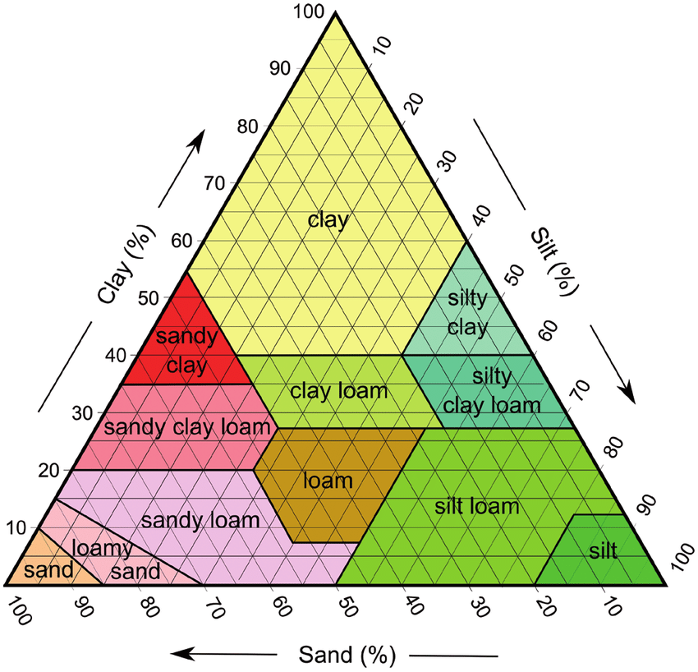
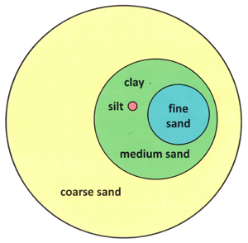
Soil Triangle
On the right is a soil triangle. It classifies soil based
on percentages of sand, silt, and clay. This can be
tested in a number of ways. Note that loam is an optimal
mixture of the three.
Below is a comparison of these mineral components
by size. Clay particles are barely visible, even at this
scale.

Slide 56
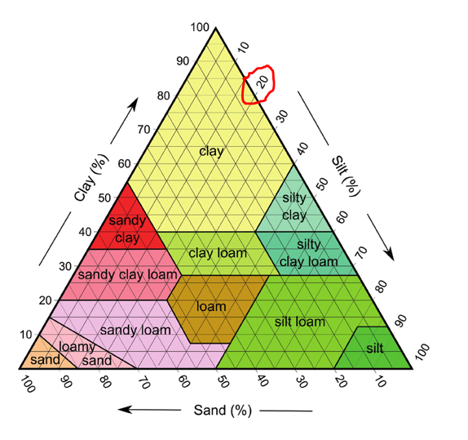
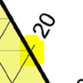
Reading A Soil Triangle
Reading a triangular graph is almost like reading a
normal two axis square plot.
The key difference is to follow the lines coming off
of the scale axis as if they are perpendicular.
Anything along the sloped highlighted line
will be 20% silt, by example.
Loam is the ideal soil breakdown, which will be
approximately 20% clay and 40% sand and silt.
Try to follow from the axes to the centre to
understand this breakdown.

Slide 57
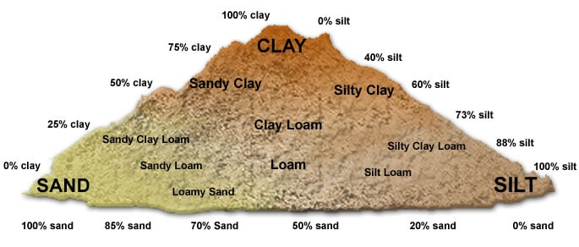
Soil Triangle Visualized

Slide 58
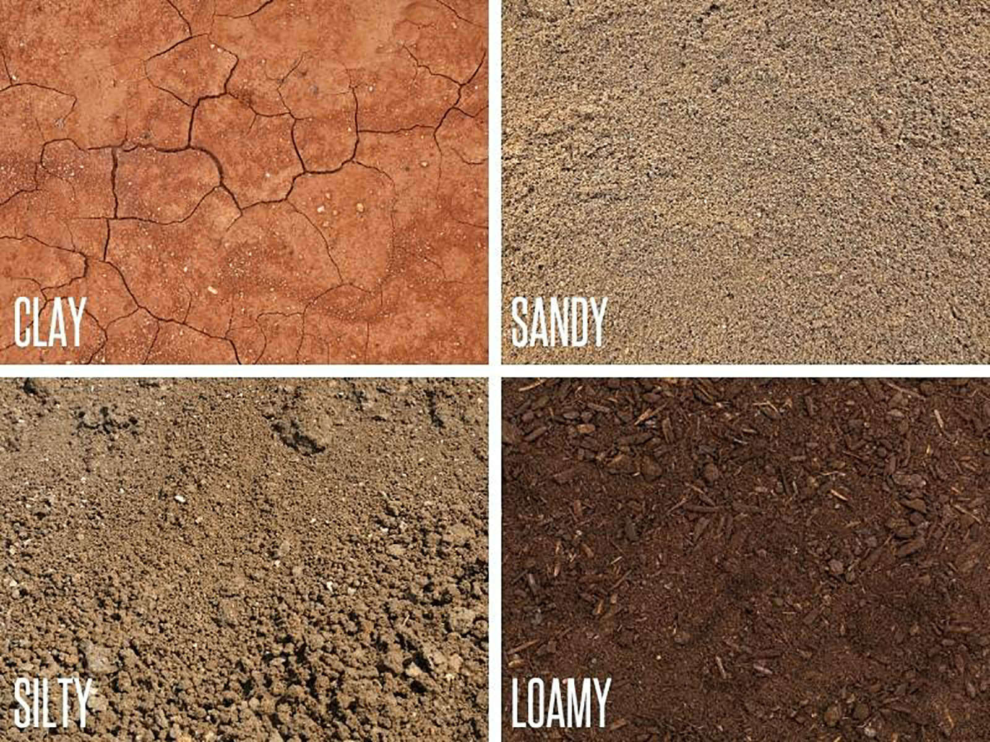
Applications of Soil Type
Independent of mineral content, any soil with relatively
large proportions of organic matter tends to be productive.
Within the soil triangle:
Soils that that are higher in sand drain better
This is due to greater spaces between larger particles
Conversely, clay rich soil requires less water
Small particles are closer packed, inhibiting water movement
Clays (as well as organic matter) are important within soil as they are
negatively charged
This allows them to attach themselves to positively charged
plant micronutrients such as calcium and magnesium cations

Slide 59
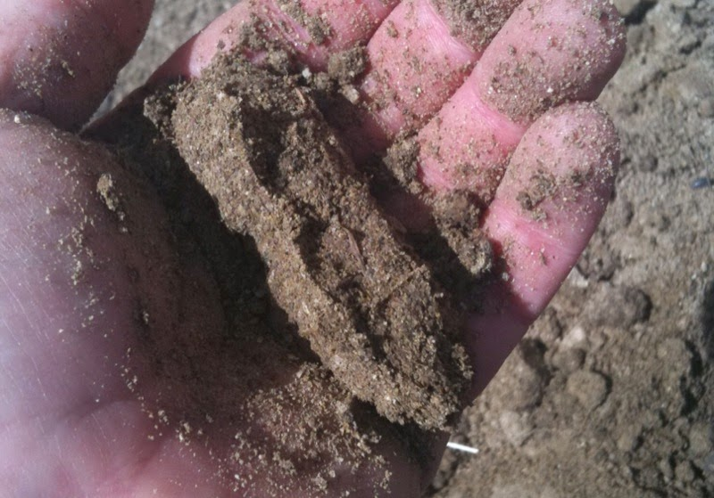
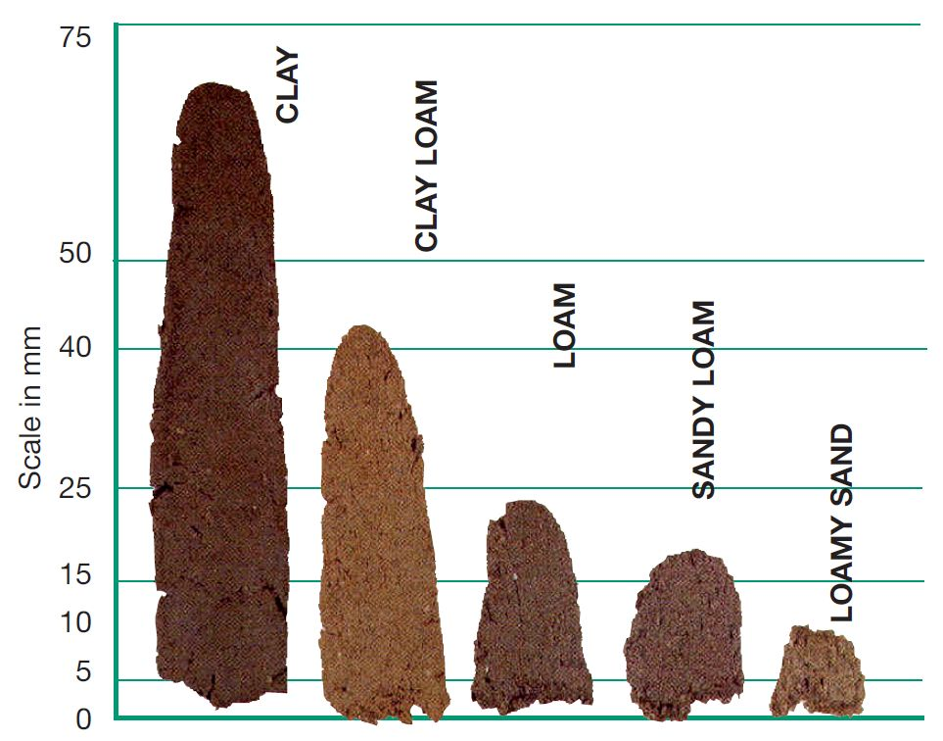
Soil composition tests:
Ball test:
Moisten a small amount of soil and squeeze it in your hand
High Sand: Will not hold its shape, feels grainy
High Clay: Will strongly hold its shape
High Silt: Will hold its shape
Loam: Barely holds its shape, crumbles when poked
Ribbon Test (works best in clay soils):
Create a soil tube by rolling it into a “ball” like above
Press it into a line in your palm with your finger
See right for the relative lengths of the ribbons
You can also find the nutrient or organic matter content by counting if there are many or few worms
More worms means more organic matter

Slide 61
Crop Rotation: Each Families Usefulness
Potato family (Solanaceae*) - tomatoes, peppers, eggplants and potatoes (but not sweet potatoes)
- Good for breaking up the clay soil so that the soil is easier to work with.
Legume family (Fabaceae*) - peas, beans, peanuts, clover and alfalfa
- Legumes grow in a symbiotic relationship with soil-dwelling bacteria which take gaseous nitrogen from the air in the soil and feed this nitrogen to the legumes; in exchange the plant provides carbohydrates to the bacteria.
Brassicas family (Brassicaceae*) - broccoli, brussel sprouts, cabbage, bok choy, broccoli, cauliflower, collard greens, rutabagas, mustard greens, nasturtium, radish, turnips, arugula and kale
- This family has large leaves that can protect the soil from too much sun light and prevent weeds.
Roots family (Apiaceae*) - carrots, parsnips, celery, parsley, fennel, cilantro, cumin and dill
- The tap roots from these plants are useful for drawing nutrients up from the deeper parts of the soil.
*scientific name for each group https://www.nourishingpursuits.com/garden/plant-families/

Slide 62
Supplementary Videos

Slide 63
Compost Time-Lapse

Slide 64
Soil Layers

Slide 65
Crop Rotation

Slide 66
How to test your soil

